Slide 2
Notes:
Speaker notes
Today, as we celebrate Pentecost Sunday, we remember the incredible moment when God’s Holy Spirit descended on Jesus’ disciples. No longer were they terrified. Each disciple was filled with God’s power and wisdom. They were empowered, they were renewed. And the effect was electric. From that moment, the Christian church began, as the disciples spread the message of Christ far and wide.
Tearfund is passionate about the local church around the world. They believe it’s through equipping local churches that communities will be led out of extreme poverty and into a sustainable future. And that is why today, on Pentecost Sunday, we are sharing the inspirational story of Rene and Odile from Ivory Coast; celebrating the incredible transformation and renewal they are experiencing.

Slide 3
Notes:
Speaker notes
The power of the church
Around the world, conflict is rife, climate change is forcing millions from their homes, and one in ten people are still living in extreme poverty. This is not God’s plan.
But there is an answer.
Together, we can release the power of the local church.

Slide 4
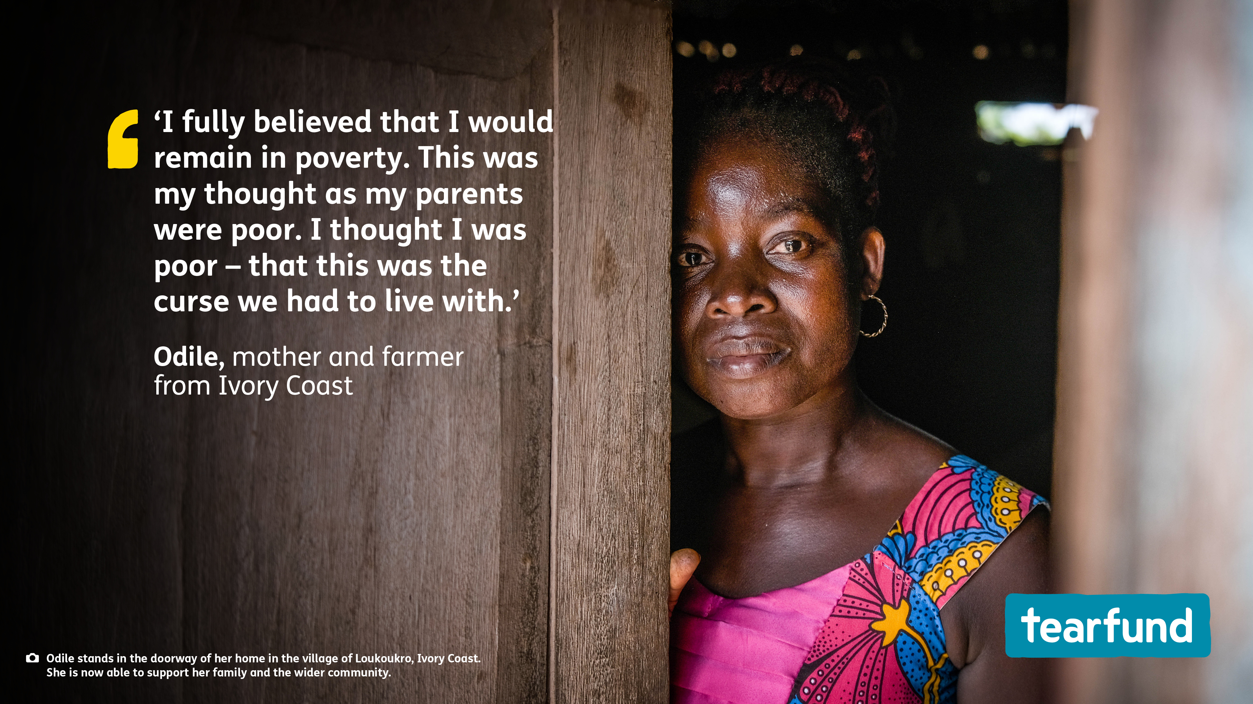

Slide 5
Notes:
Speaker notes
A recent independent study into the impact of Tearfund’s training through local churches found that people living in communities that have been through Tearfund's Church and Community Transformation training are:
113% more likely to work on shared projects
51% more likely to have maintained or increased their income in the last year
35% more likely to be hopeful about the future

Slide 6
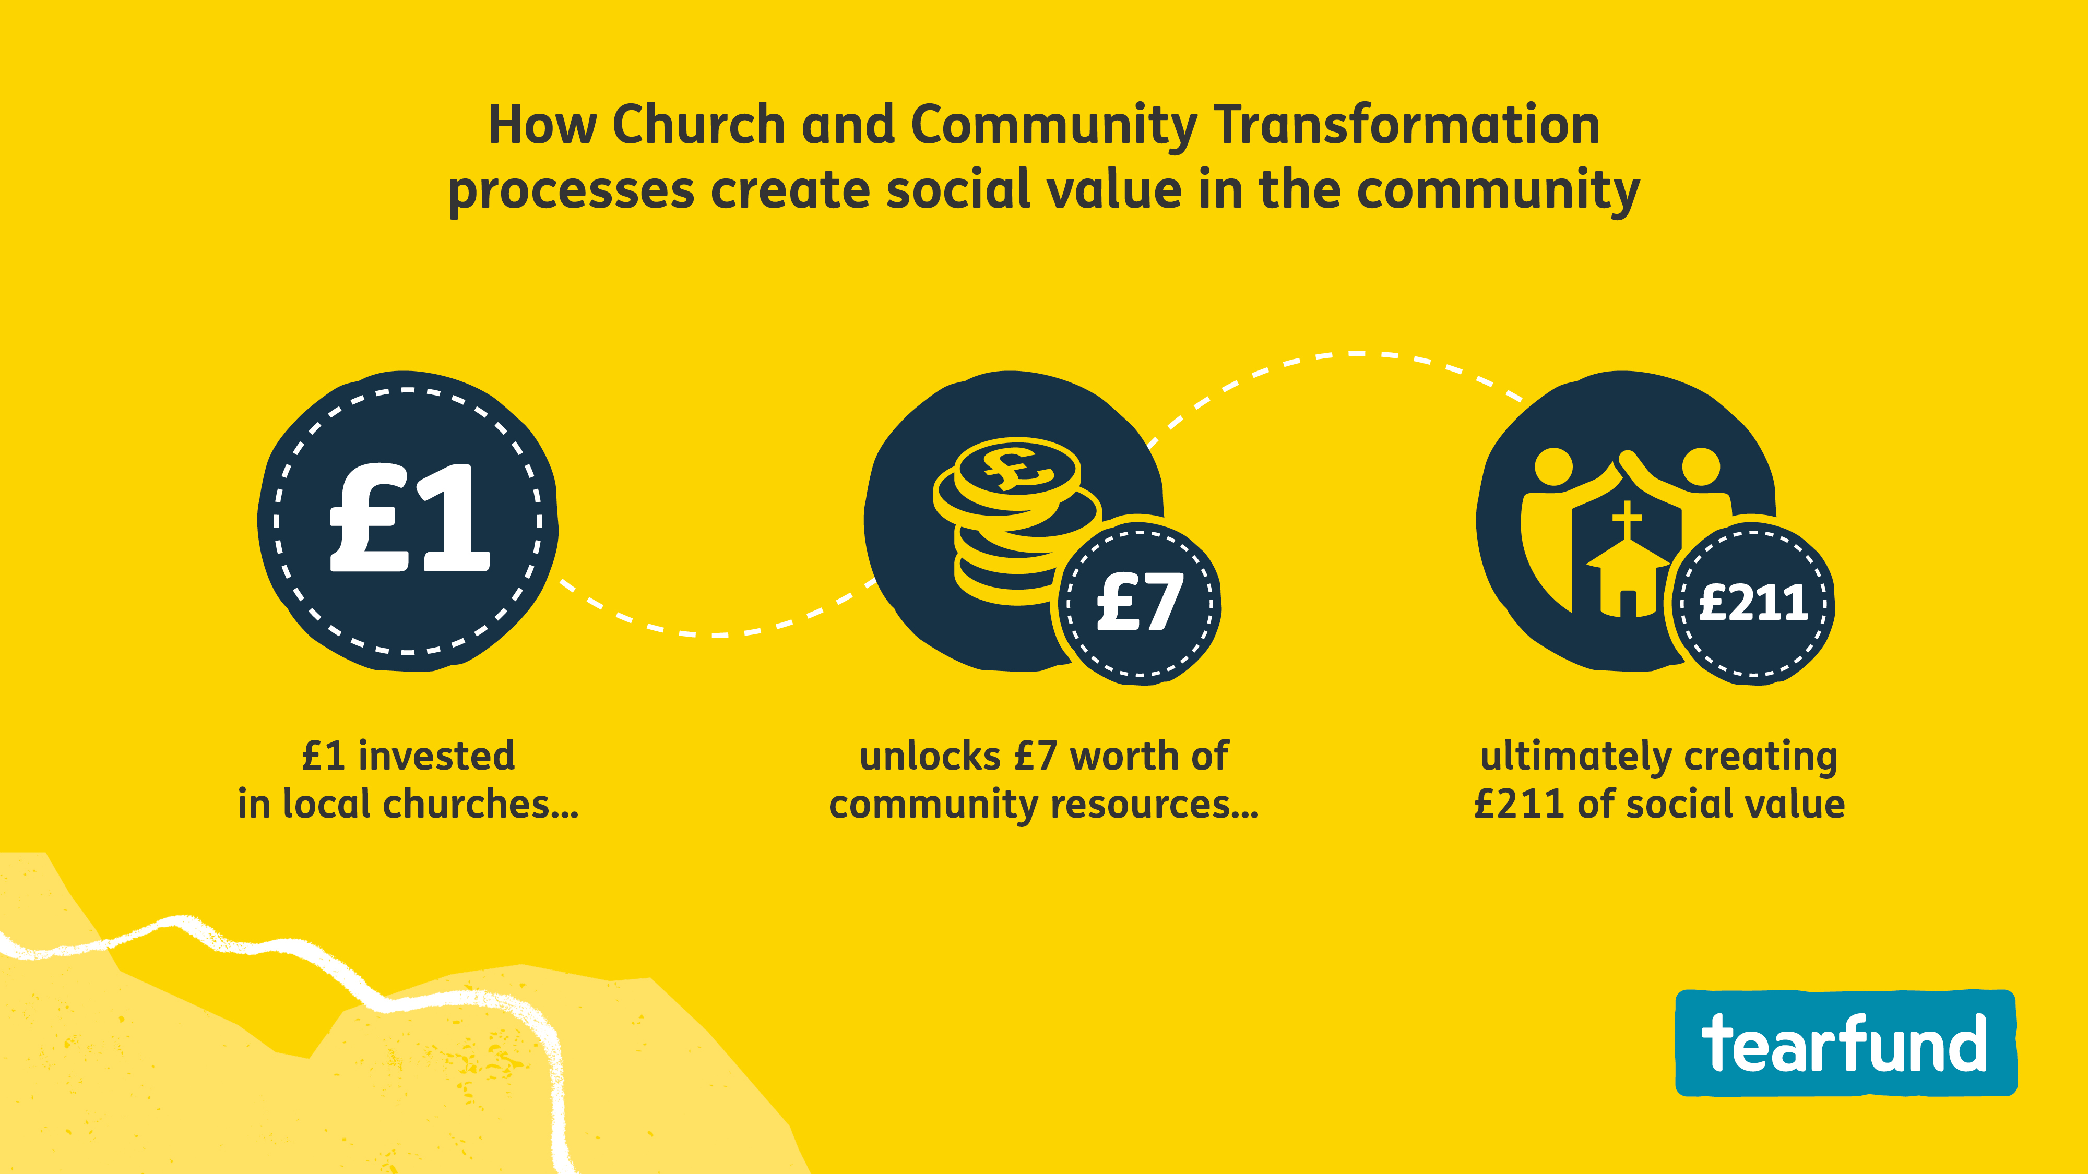
Notes:
Speaker notes
Tearfund’s Church and Community Transformation training, delivered through the local church, helps communities recognise the skills and resources God has given them to overcome poverty from within and build greater resilience – with immediate effect.
A recent independent study into the impact of Tearfund's training through local churches found that every £1 invested by Tearfund in local churches helps the community to unlock a further £7 in time and resources for shared projects, which ultimately creates £211 of social value through improved wellbeing.
(Social value measurement aims to put a monetary value to costs and benefits that do not have a market price. These include improved quality of life, increased trust in neighbours, or an improved natural environment.)

Slide 7
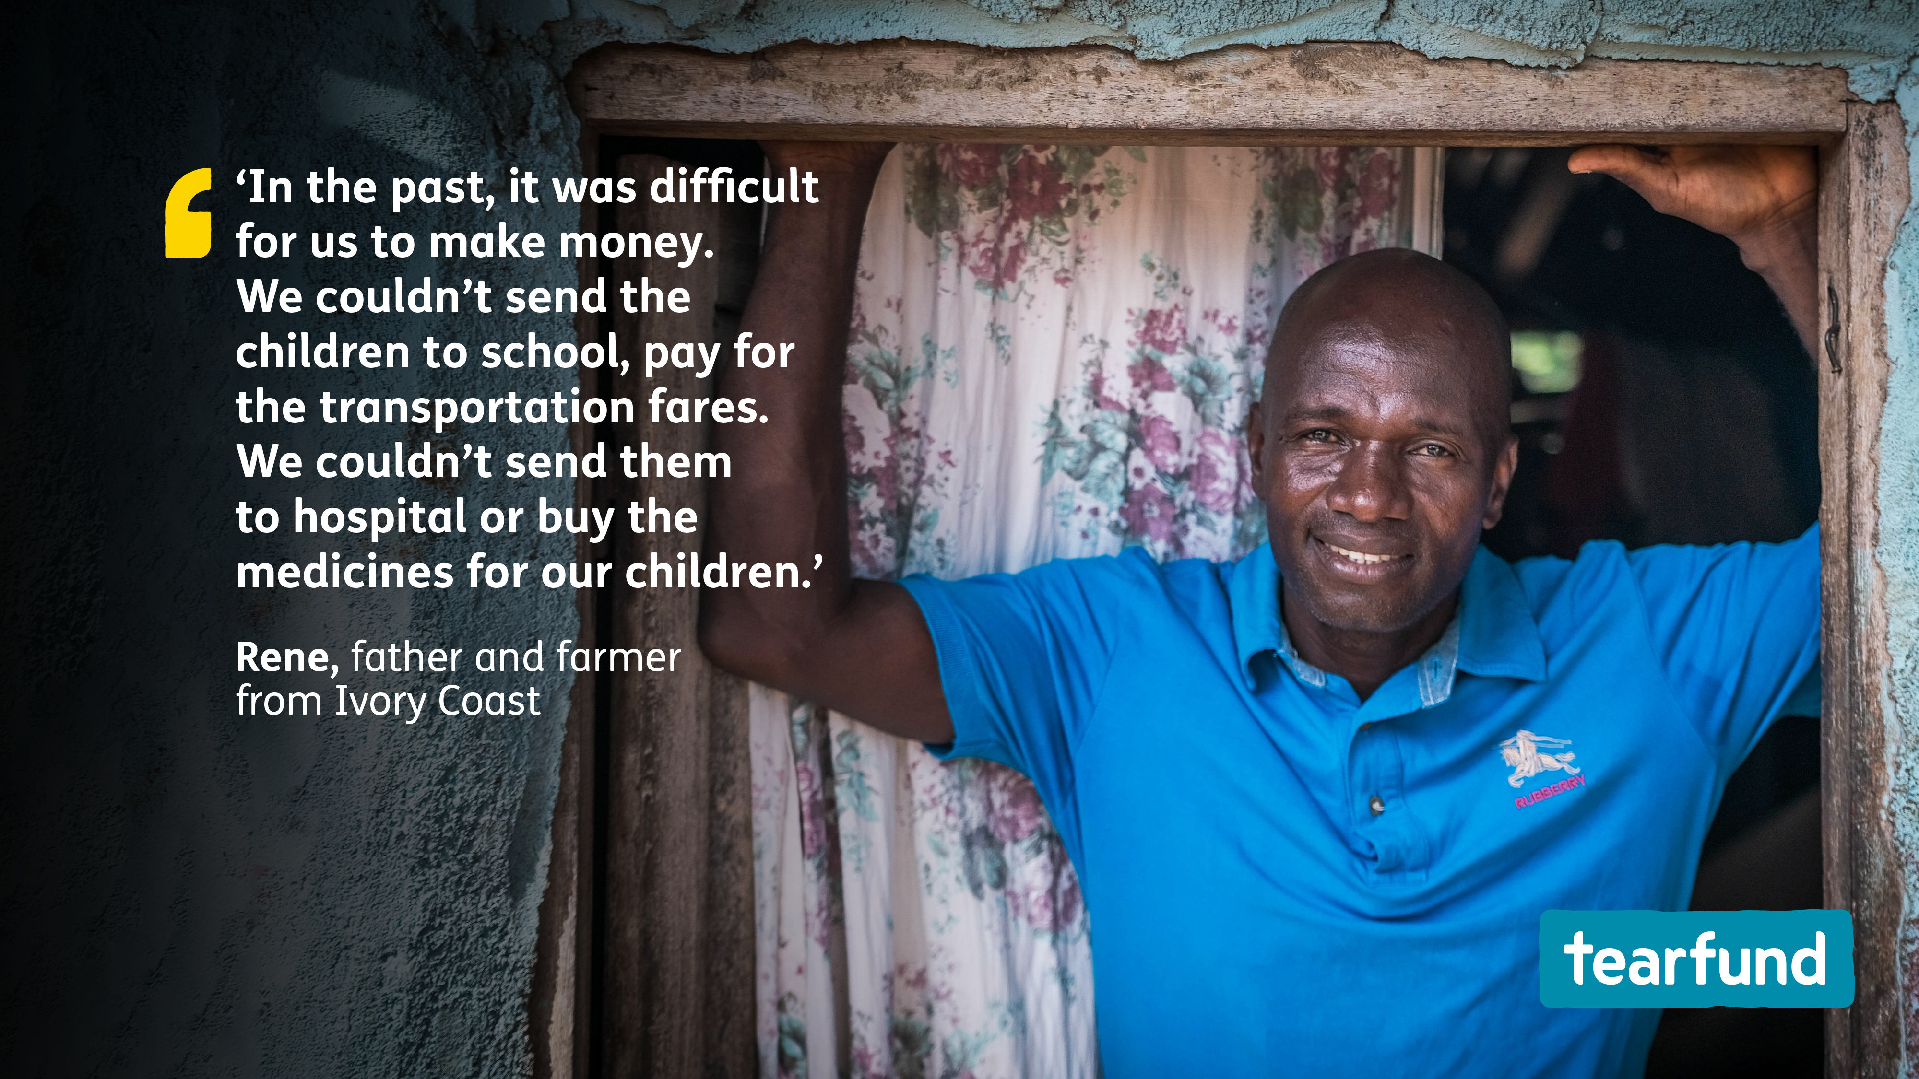
Notes:
Speaker notes
Rene and Odile from Ivory Coast lived in fear and worry. The couple could barely afford to put food on the table – let alone pay for school fees, or for medicine when their children got sick.
But all this changed when Tearfund’s Bible-based training – delivered through the local church – equipped them to realise and unlock their God-given potential.
Today, Rene and Odile have a thriving pineapple business.
When communities are empowered to fulfil their God-given potential, everything changes.

Slide 8
Notes:
Speaker notes
Pastor Amani from Ivory Coast shares how his church community has gone from strength to strength since Tearfund’s bespoke community training arrived. Pastor Amani explains, ‘When I arrived at the church, Christians had this mentality that they had to remain poor in order to inherit heaven, especially eternal life.’ But through Tearfund’s bespoke community training, with Bible studies on recognising the skills and resources God has given them to overcome poverty from within, Pastor Amani walked alongside his parish as they changed.
Today, the community has stronger relationships, the church building is nearly complete, families are working hard to farm and be self-sufficient, and the church congregation and its income have tripled in size. ‘Tearfund’s Transforming Communities programme is an instrument for development, for transforming people's way of thinking,’ says Pastor Amani.

Slide 10
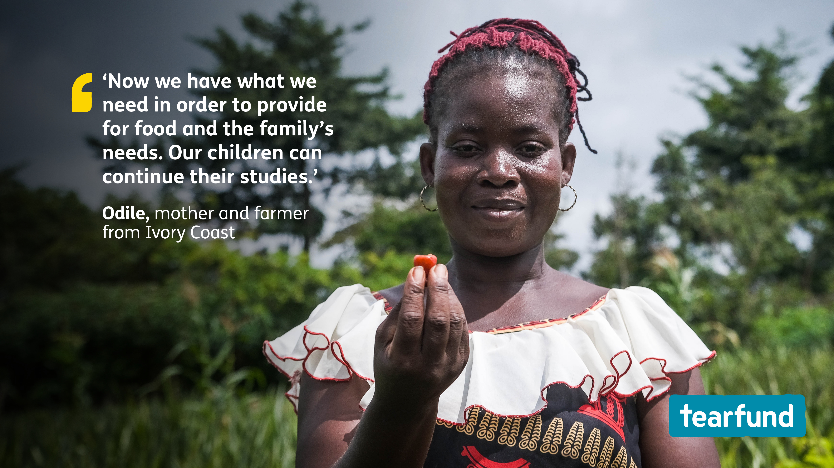
Notes:
Speaker notes
It’s been wonderful to hear recent updates from Rene and Odile about how their business is growing and their community is thriving.
Odile shares how last year she was able to save almost £200 through a community savings group that began as a result of Tearfund’s training. Odile cultivated a small vegetable garden and put aside the money she made from selling tomatoes. £200 is more than double the minimum monthly wage in Ivory Coast and this saving enabled her family to expand the size of their farm and plant more pineapples.
Rene also shares how his business has grown, and in particular, how the community is living in harmony.
‘Through Tearfund’s Transforming Communities programme, I've learnt to discover the authority God has given us by putting resources at our disposal,’ explains Rene. ‘Among the resources we have are health, financial resources and the people around us. Today, through Tearfund’s training, I am the owner and cultivate a two-hectare field of yams, pineapples and peanuts.’

Slide 11
Notes:
Speaker notes
Let us pray that Tearfund’s partners will be able to reach many more communities with Tearfund’s Bible-based training so that they can be equipped to realise and unlock their God-given potential.

Slide 12
Notes:
Speaker notes
Let us pray that Tearfund’s partners will be able to reach many more communities with Tearfund’s Bible-based training so that they can be equipped to realise and unlock their God-given potential.

