Slide 2
Notes:
Speaker notes
The power of the church
Around the world, conflict is rife, climate change is forcing millions from their homes, and one in ten people are still living in extreme poverty. This is not God’s plan.
But there is an answer.
Together, we can release the power of the local church.

Slide 3
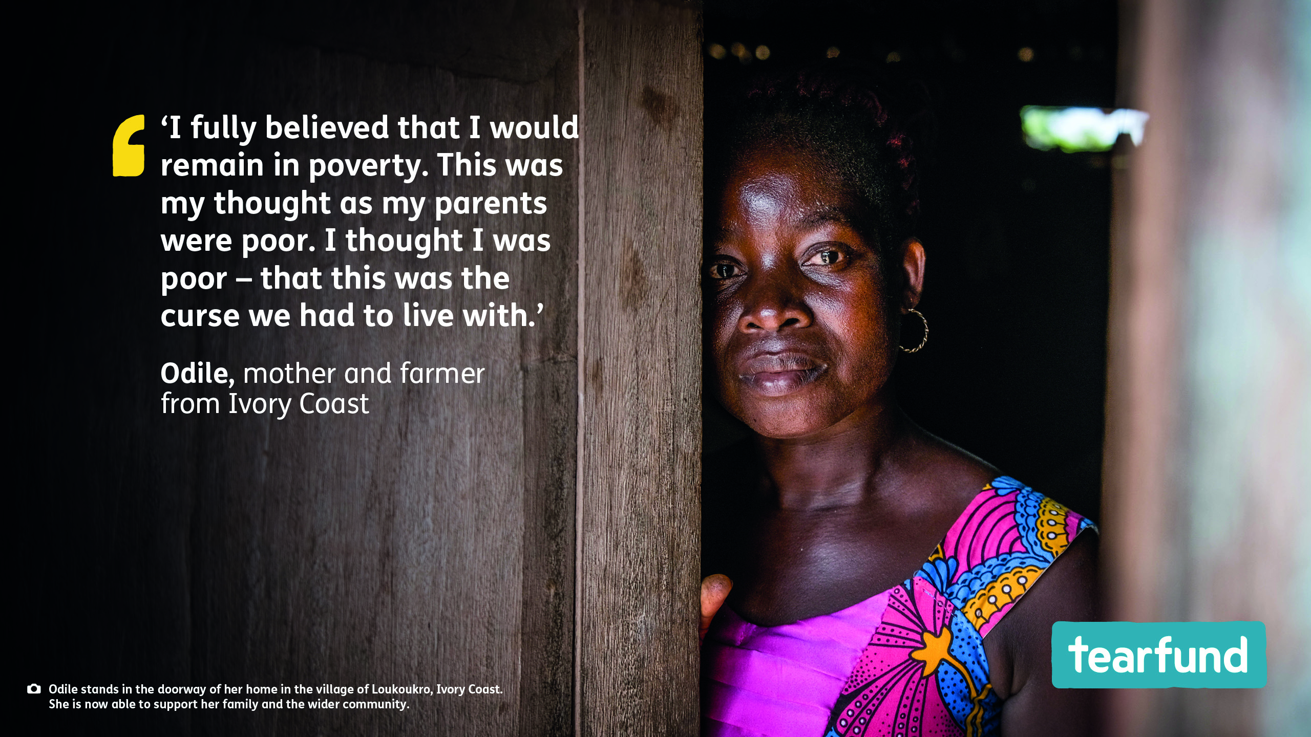

Slide 4
Notes:
Speaker notes
A recent independent study into the impact of Tearfund’s training through local churches found that people living in communities that have been through Tearfund's Church and Community Transformation training are:
113% more likely to work on shared projects
51% more likely to have maintained or increased their income in the last year
35% more likely to be hopeful about the future

Slide 5
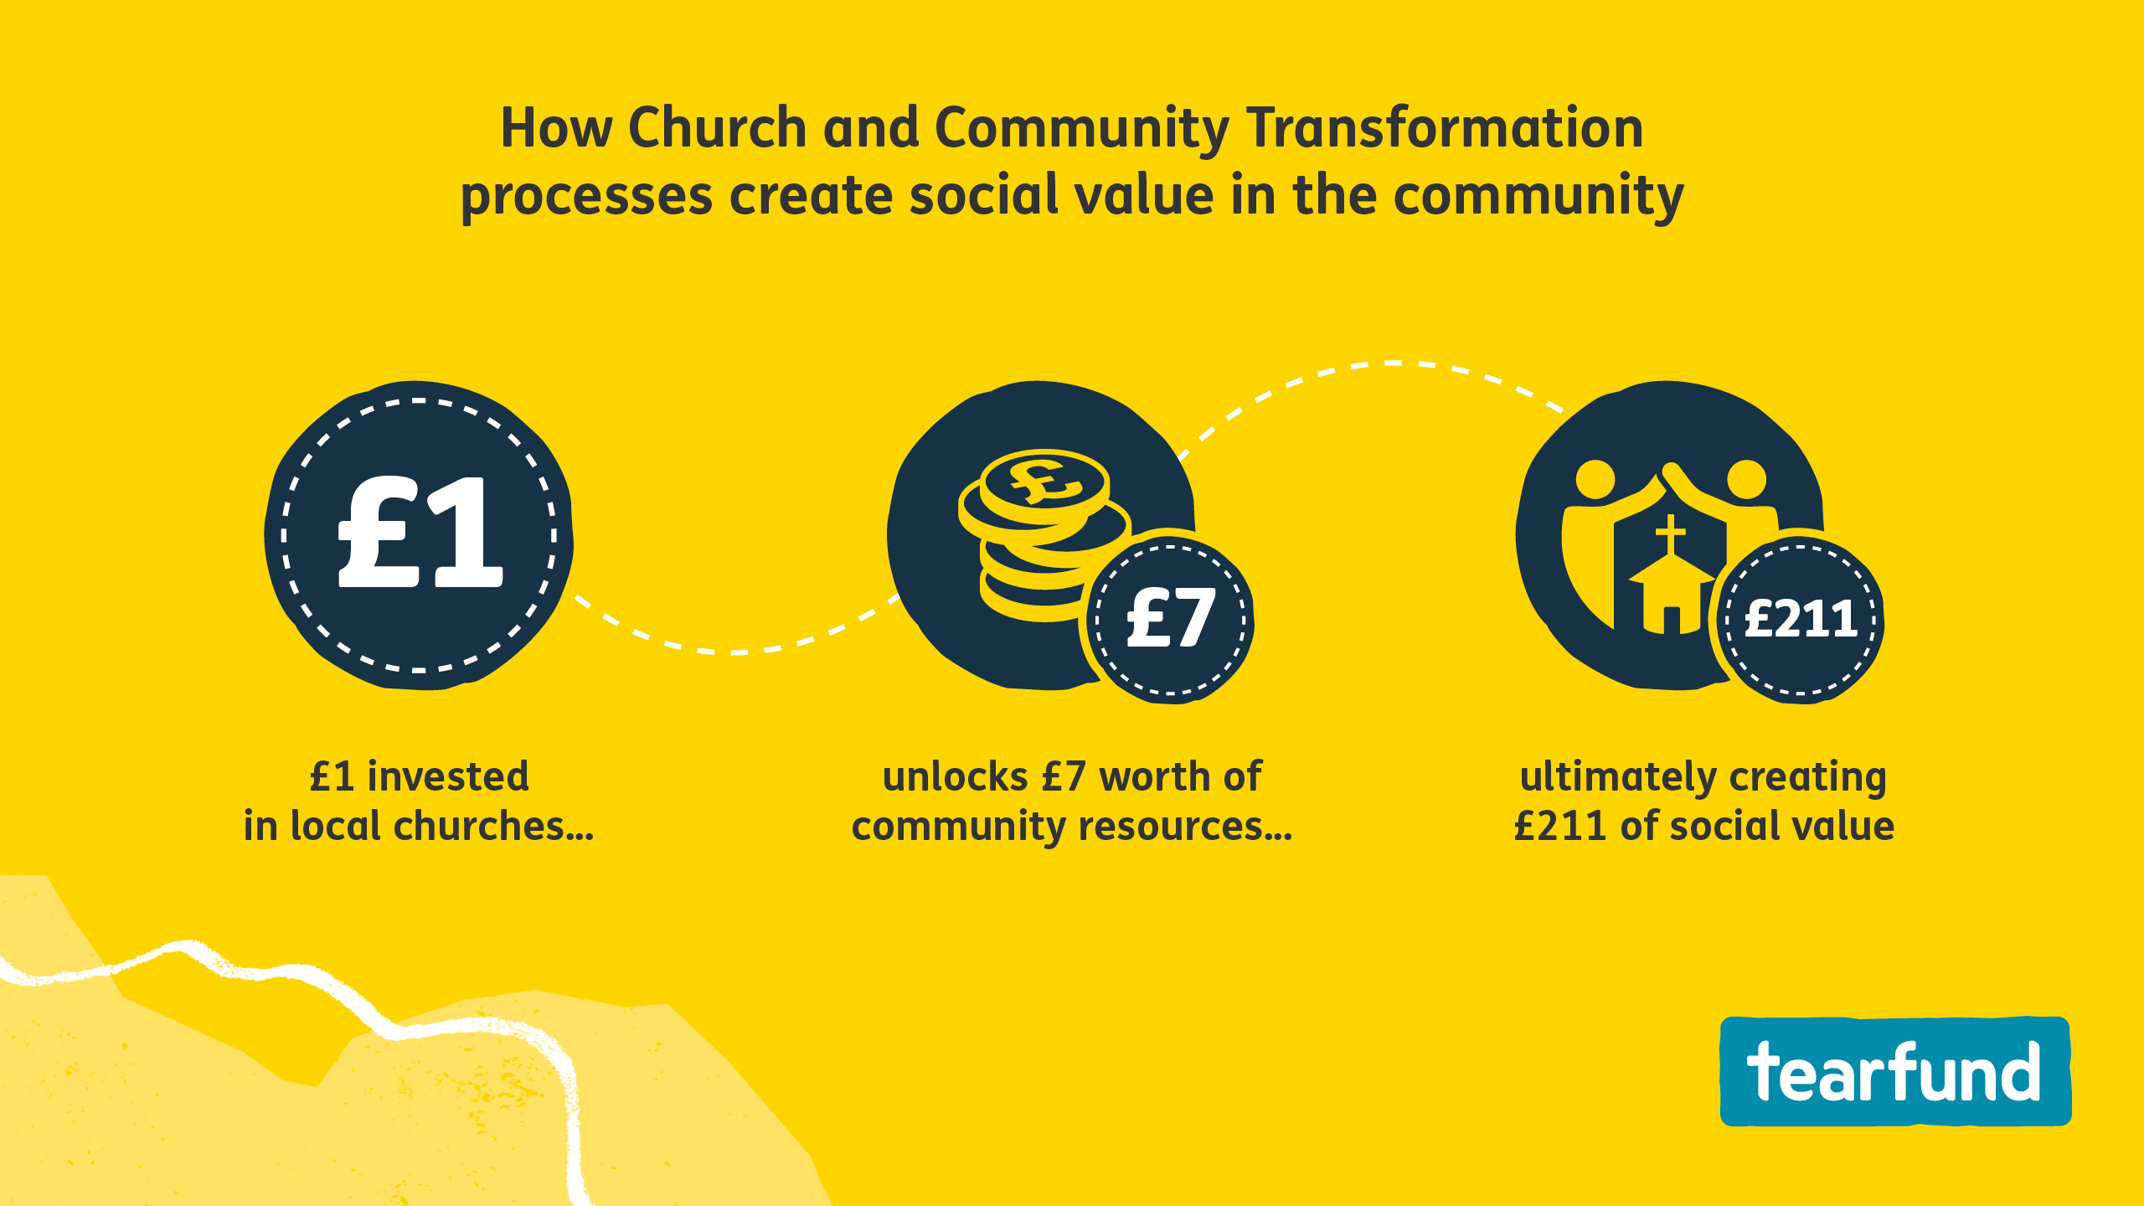
Notes:
Speaker notes
Tearfund’s Church and Community Transformation training, delivered through the local church, helps communities recognise the skills and resources God has given them to overcome poverty from within and build greater resilience – with immediate effect.
A recent independent study into the impact of Tearfund's training through local churches found that every £1 invested by Tearfund in local churches helps the community to unlock a further £7 in time and resources for shared projects, which ultimately creates £211 of social value through improved wellbeing.
(Social value measurement aims to put a monetary value to costs and benefits that do not have a market price. These include improved quality of life, increased trust in neighbours, or an improved natural environment.)

Slide 6
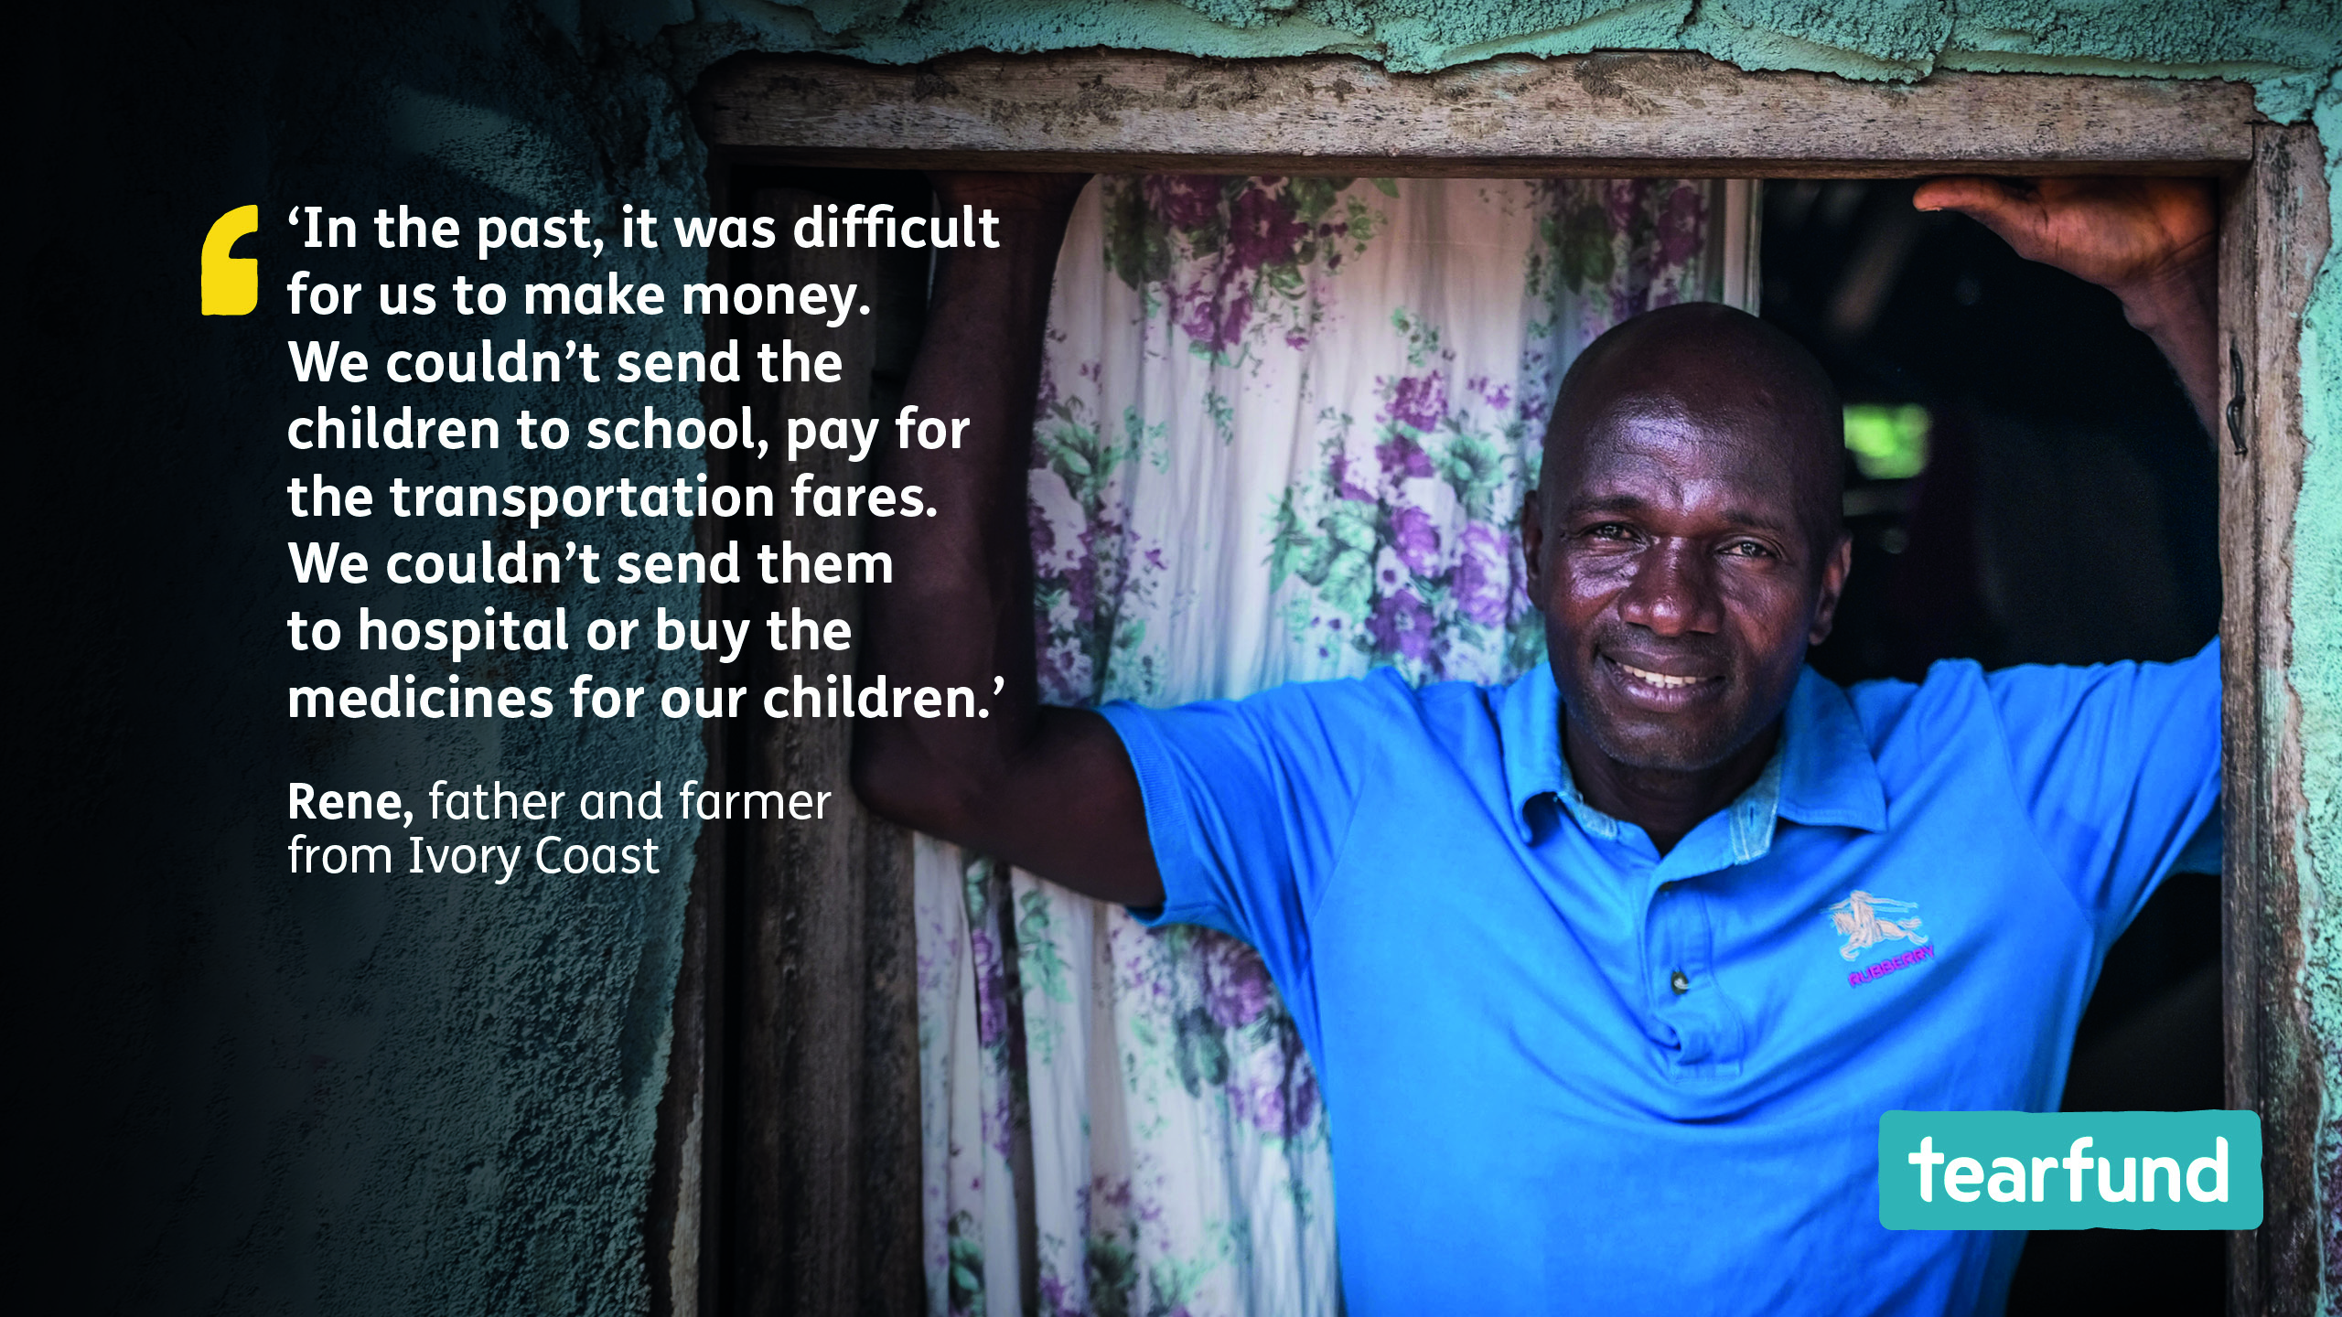
Notes:
Speaker notes
Rene and Odile from Ivory Coast lived in fear and worry. The couple could barely afford to put food on the table – let alone pay for school fees, or for medicine when their children got sick.
But all this changed when Tearfund’s Bible-based training – delivered through the local church – equipped them to realise and unlock their God-given potential.
Today, Rene and Odile have a thriving pineapple business.
When communities are empowered to fulfil their God-given potential, everything changes.

Slide 8
Notes:
Speaker notes
Let us pray that Tearfund’s partners will be able to reach many more communities with Tearfund’s Bible-based training so that they can be equipped to realise and unlock their God-given potential.

Slide 9
Notes:
Speaker notes
Let us pray that Tearfund’s partners will be able to reach many more communities with Tearfund’s Bible-based training so that they can be equipped to realise and unlock their God-given potential.

