Slide 3
What happens to
my rubbish when I throw it away?

Slide 4
In the UK we throw away enough plastic to fill a double-decker bus every 15 seconds

Slide 5
‘It only has to rain and everything floods. A lot of rubbish comes down the river. What I see most are water bottles, and fizzy drink bottles, mostly Coca-Cola, the type of bottles that are not returnable.’
Daiane Maria, Brazil

Slide 7
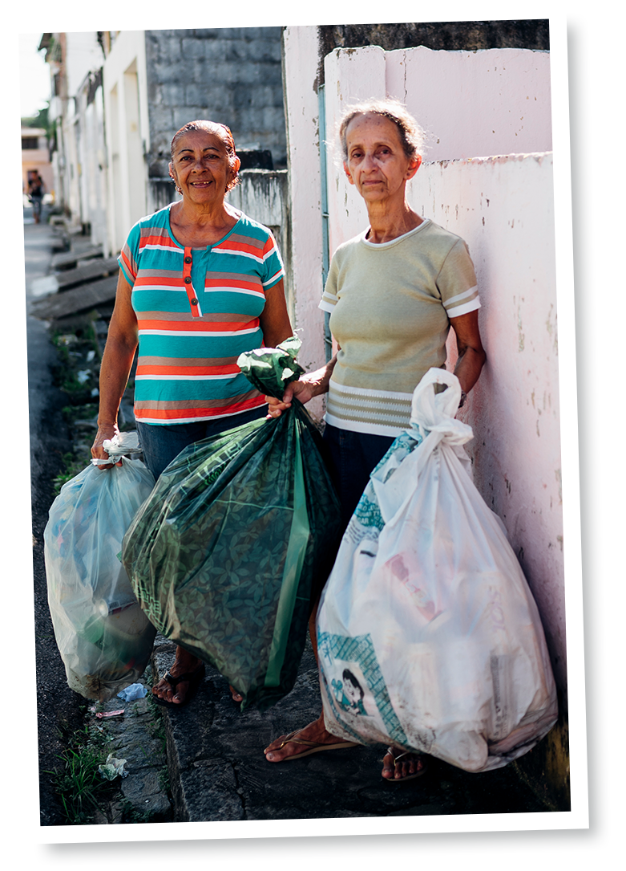
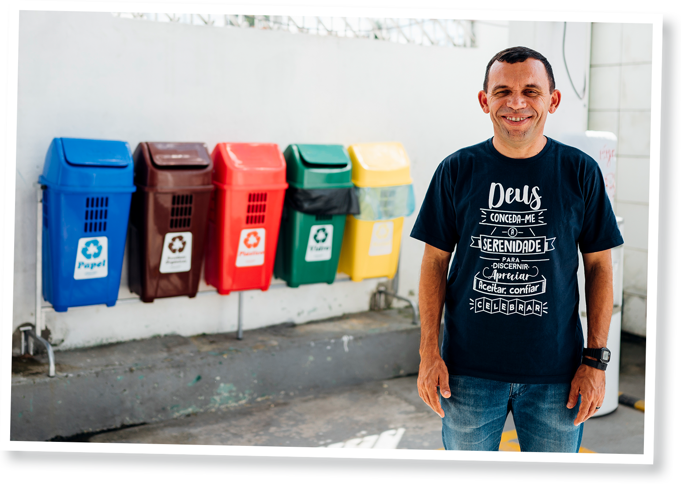
Rubbish collectors Maria Delurdes Ramos and Zelda Rufono Dos Santos stand with bags of waste collected in the local street.
Photo: Ruth Towell/Tearfund
Pastor Jose stands in front of recycling bins in his church, Coqueiral Baptist Church.
Photo: Ruth Towell/Tearfund

Slide 12
Example template slide
Bullet points could go here.
Bullet points could go here.
Bullet points could go here.
Bullet points could go here.
Bullet points could go here.

Slide 13
Example template slide using a long title over two lines
Bullet points could go here.
Bullet points could go here.
Bullet points could go here.
Bullet points could go here.
Bullet points could go here.

Slide 15
Example template slide
Bullet points could go here.
Bullet points could go here.
Bullet points could go here.
Bullet points could go here.
Bullet points could go here.

Slide 16
Example template slide using a long title over two lines
Bullet points could go here.
Bullet points could go here.
Bullet points could go here.
Bullet points could go here.
Bullet points could go here.

